Slide 1

Computer Programming Capstone Project
Samuel Bowes
6/24/2021

Slide 2
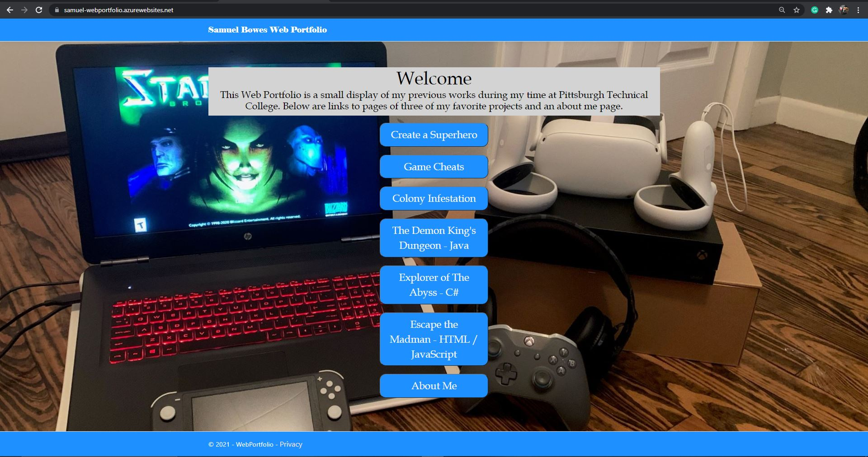
Web Interface
The Websites Design was meant to be simple for users.
The Home screen has all the options for viewing other pages.
The Blue Buttons at the center take the user to the titled pages.

Slide 3
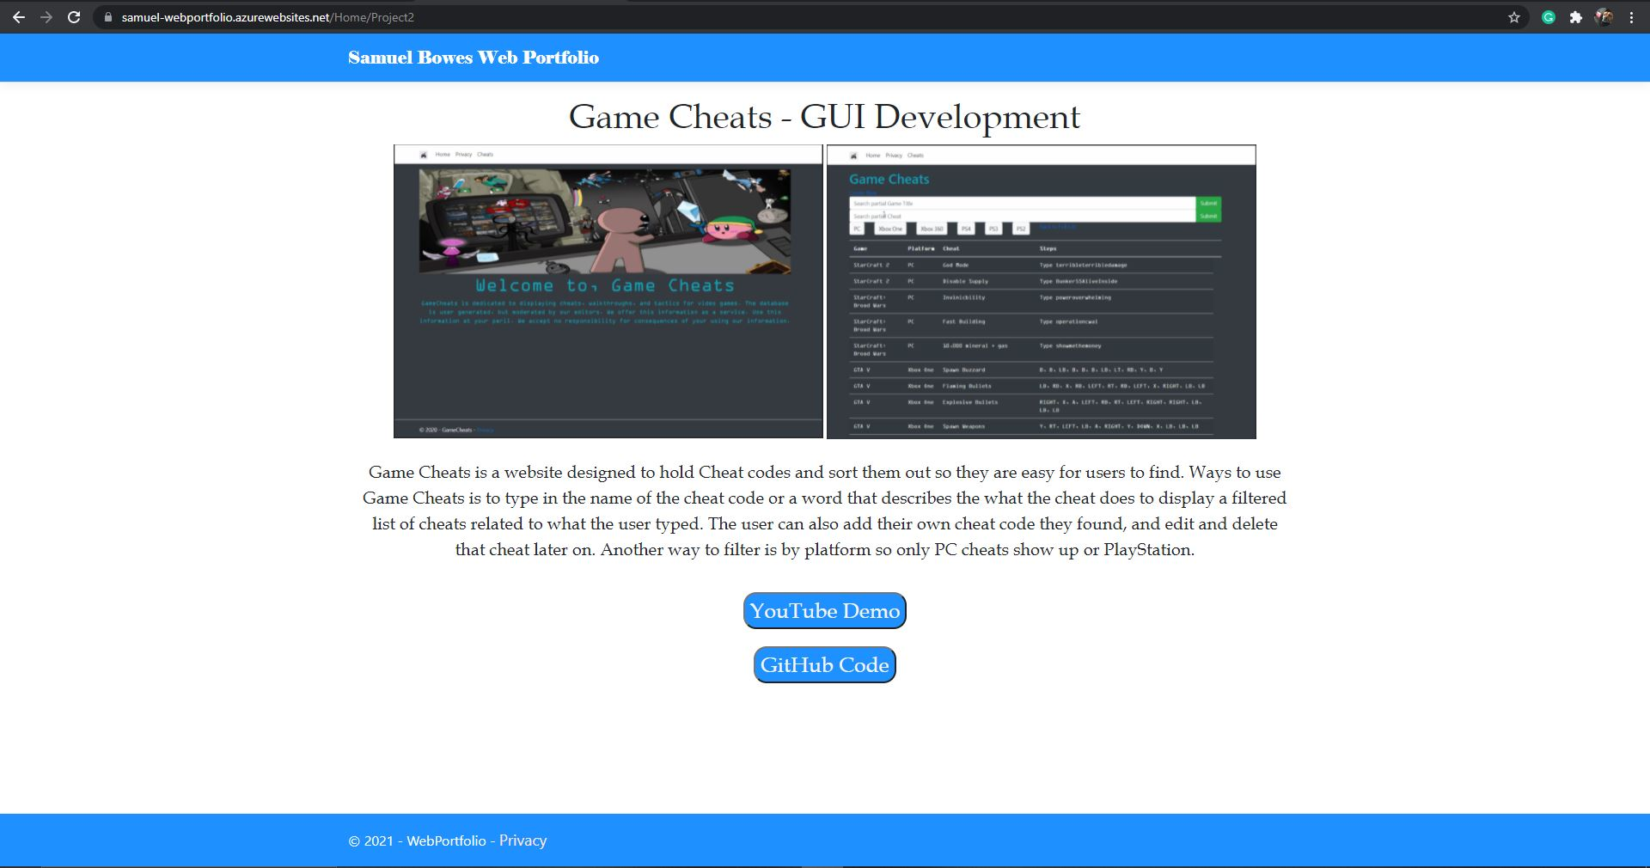
Project Pages
The Title in the top left is used to return to the Home Page.
A description and two images of the project.
Links to a YouTube demo and GitHub Code.

Slide 4
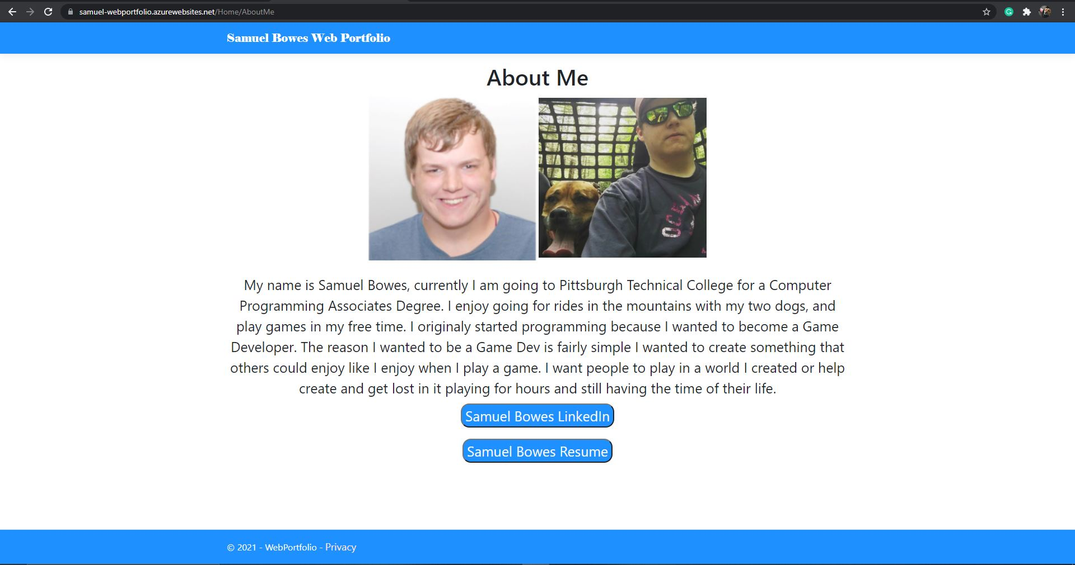
About Me Page
The ‘About Me’ page has a small description of things I enjoy doing, and hobbies.
It also has links to my LinkedIn page as well as my Resume for any possible employers.

Slide 5
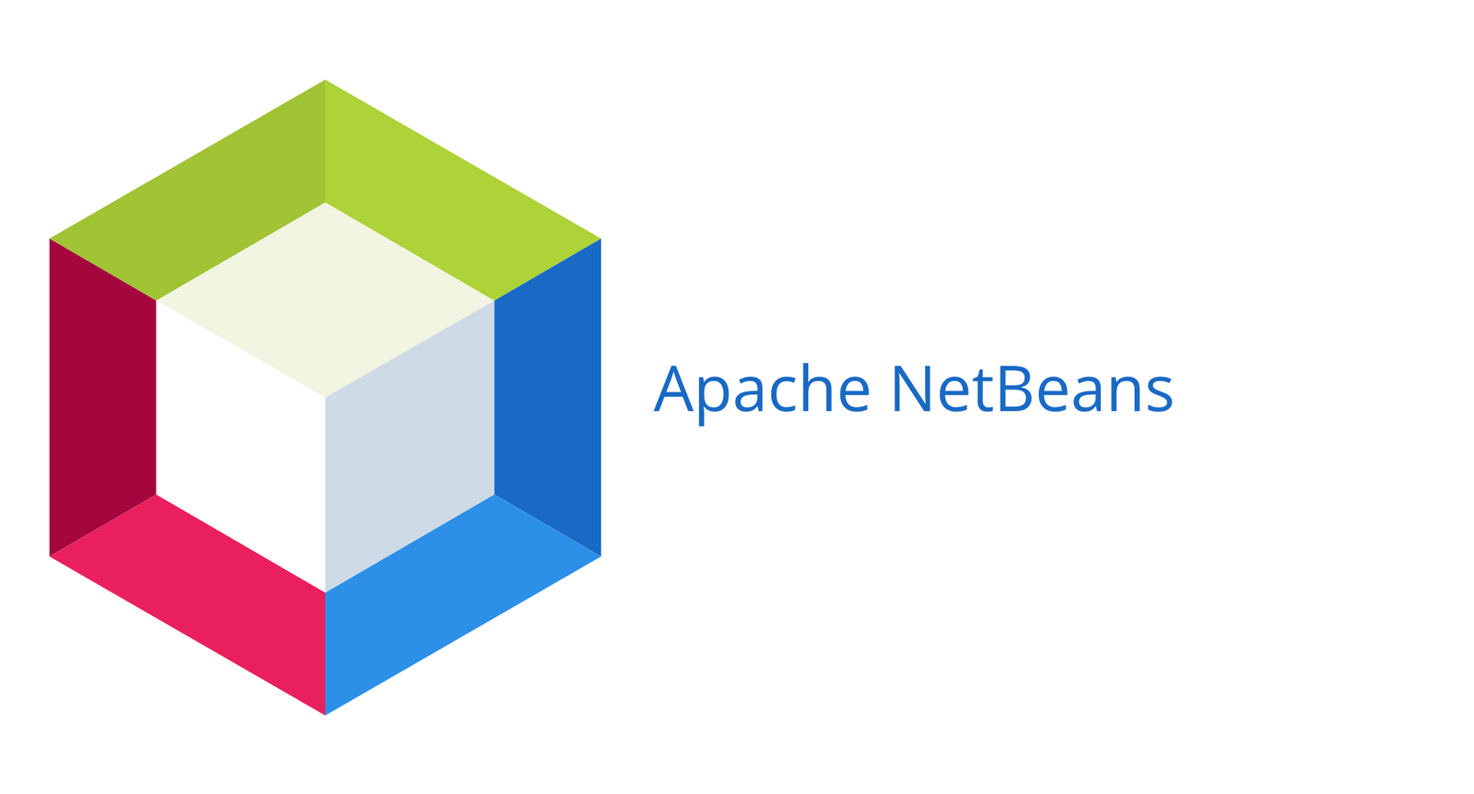
Project 1: The Demon King’s Dungeon - Program
Created in Apache NetBeans
The Console was used for the Program
Simple to use and try new things.

Slide 6

Project 1 : The Demon King’s Dungeon - Language
Java
Java is my 2nd best language.
It is easy to use for this type of project.
It helps with writing to make things smoother.

Slide 7
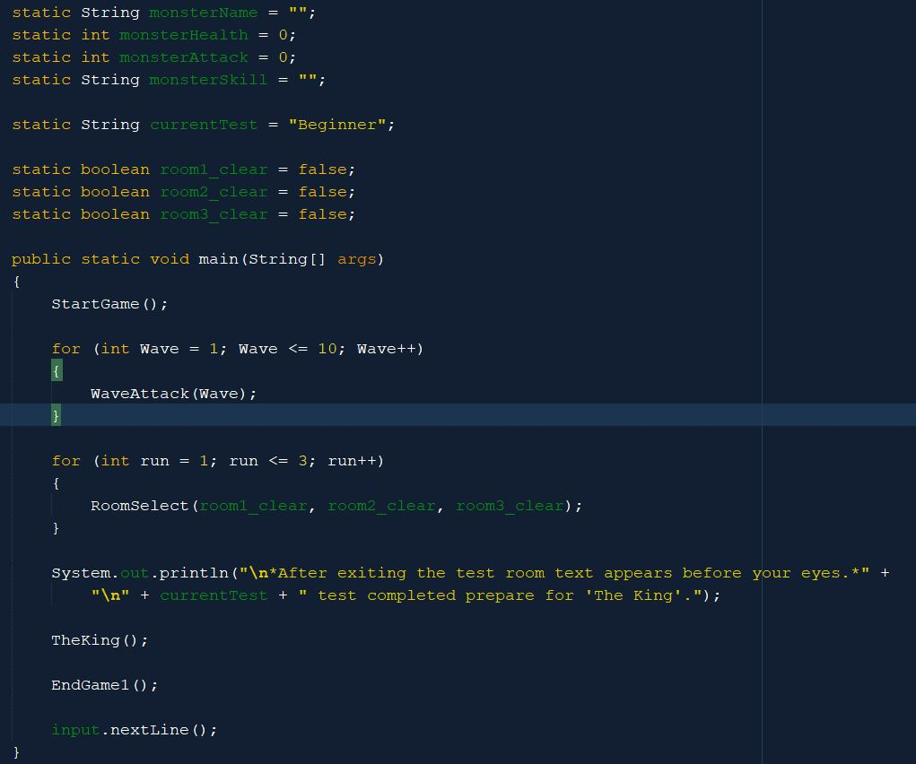
Project 1 : The Demon King’s Dungeon - Process
The Project was created section by section.
Each section was its own Function with layers to it.
I would create the section I thought of then choose what to do next or how to do it.

Slide 8
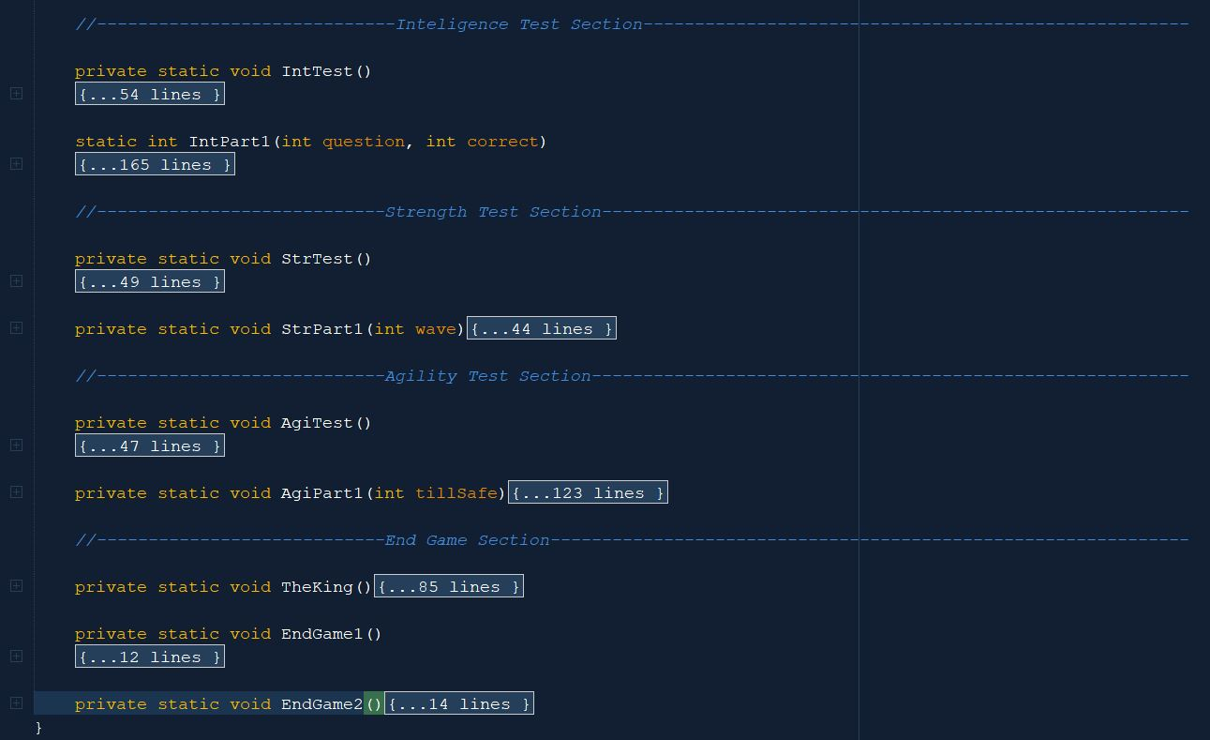
Project 1 : The Demon King’s Dungeon - Document
Commenting was used to organize sections of code.
Sections would contain all functions that applied to it.
Certain lines of important code were labeled as well.

Slide 9
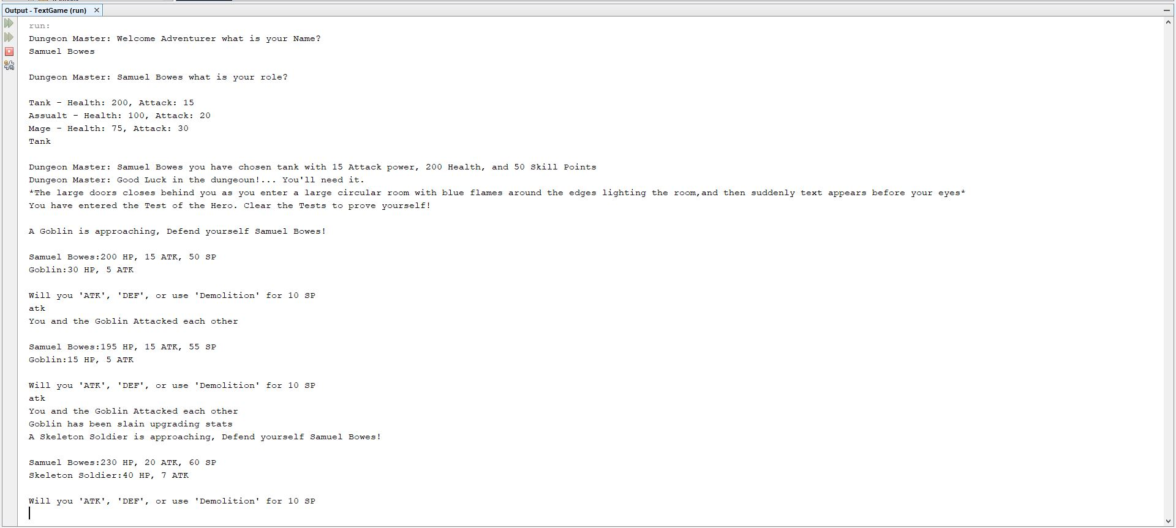
Project 1 : The Demon King’s Dungeon - Mechanics
The Game has a Class System.
A fighting systems for Bosses and Minions.
Tests that have a relevance to classes.
Changing dialog based on different factors.

Slide 10
Project 1 : The Demon King’s Dungeon - Reflection
Positives
The complex mechanics turned out well.
The story I had was good.
Forced me to think of new ideas.
Negatives
Had to go back and make many changes.
Dragged my feet on much of it.
A lot of the same code.

Slide 11

Project 2: Explorer of the abyss - Program
Made using Unity.
I had the most fun creating games.
Using/Creating Assets.
Used in most recent classes.

Slide 12
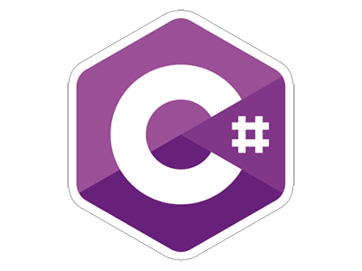
Project 2: Explorer of the abyss - Language
C#
C# is my best Programming Language.
The program helps with writing.
Plenty of sources of information to help.

Slide 13
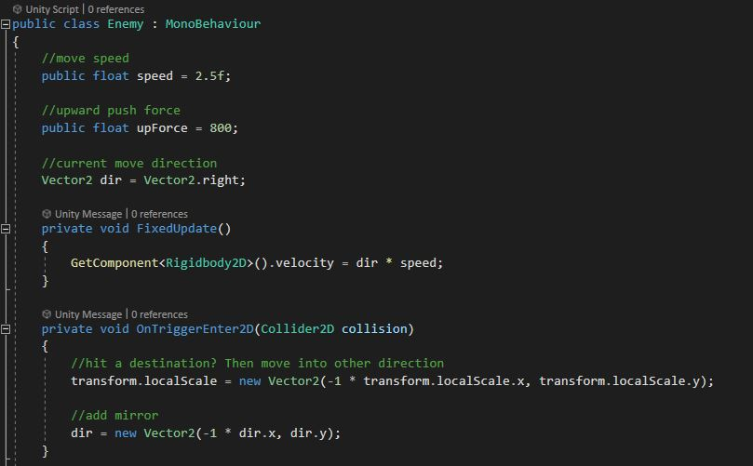
Project 2: Explorer of the abyss - Process
Most of the coding used FixedUpdate().
OnCollisionEnter2D() was used for most of the player interactable objects.
Animators were used as well for anything that move.

Slide 14
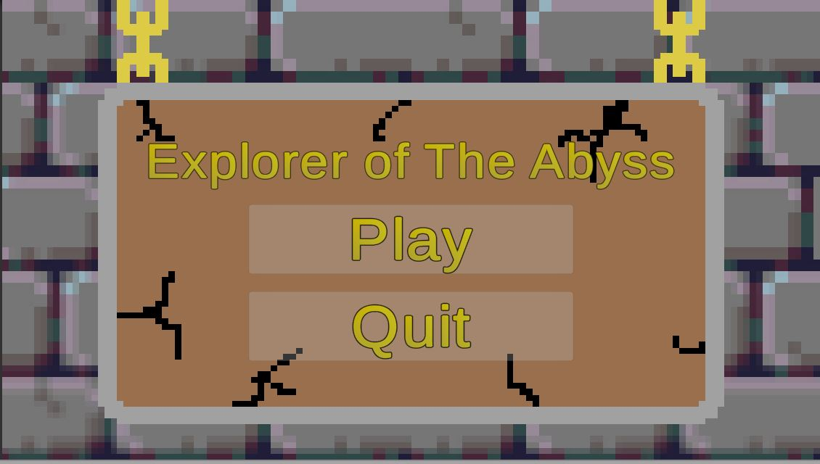
Project 2: Explorer of the abyss - Document
Any of the more important lines of code were labeled.
Most scripts had one function to them, so labeling was limited.
Scripts with multiple functions had more documentation.

Slide 15
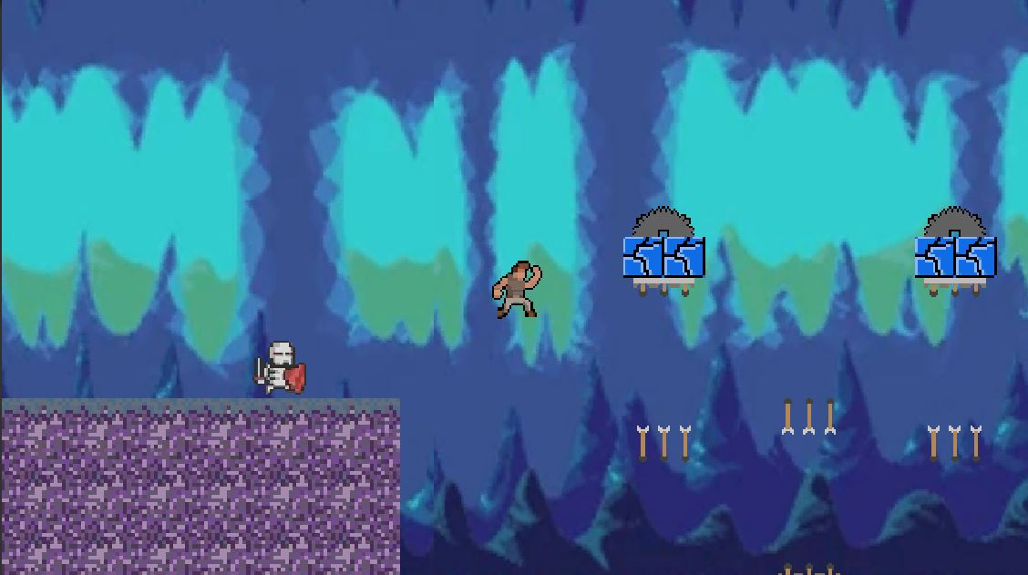
Project 2: Explorer of the abyss - Mechanics
The Game is close to Mario.
Player can jump, wall jump.
Arrow traps fire on a timer.
Skeletons roam a set area.
Saw blades make a constant sound.
Gates need a set number of keys collected to open to next level.

Slide 16
Project 2: Explorer of the abyss - Reflection
Positives
Fun to make.
Challenging to create entire levels.
Trying something new I had not learned.
Negatives
Could have tried a new game idea.
Limited myself to what I knew with little new ideas.

Slide 17

Project 3: Escape the madman - Program
Created using Brackets.
Best for what I had planned.
Simple and freeform to use.

Slide 18
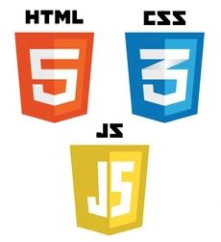
Project 3: Escape the madman - Language
HTML, JavaScript, CSS
HTML was easy to use for this project.
CSS made the designing simple for multiple pages.
JavaScript was the key here which is my worst programming language.

Slide 19
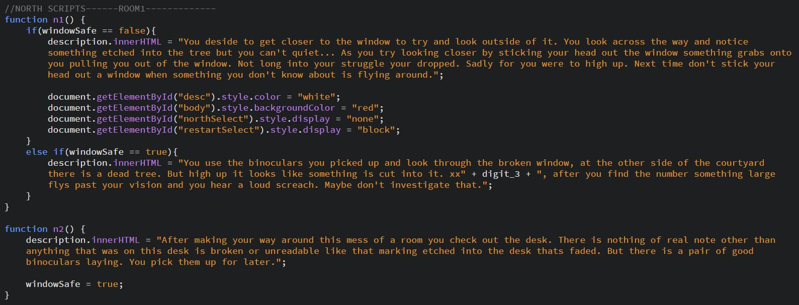
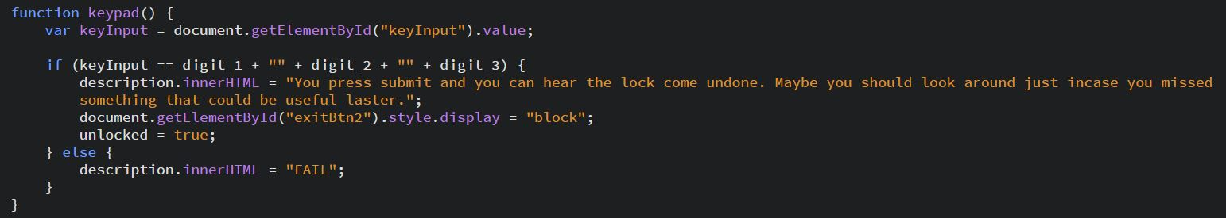
Project 3: Escape the madman - Process
Most of the JavaScript Functions simply changed Description Text.
Some Functions would cause the player to lose unless requirements were met.
There were also functions that required set inputs to pass.

Slide 20
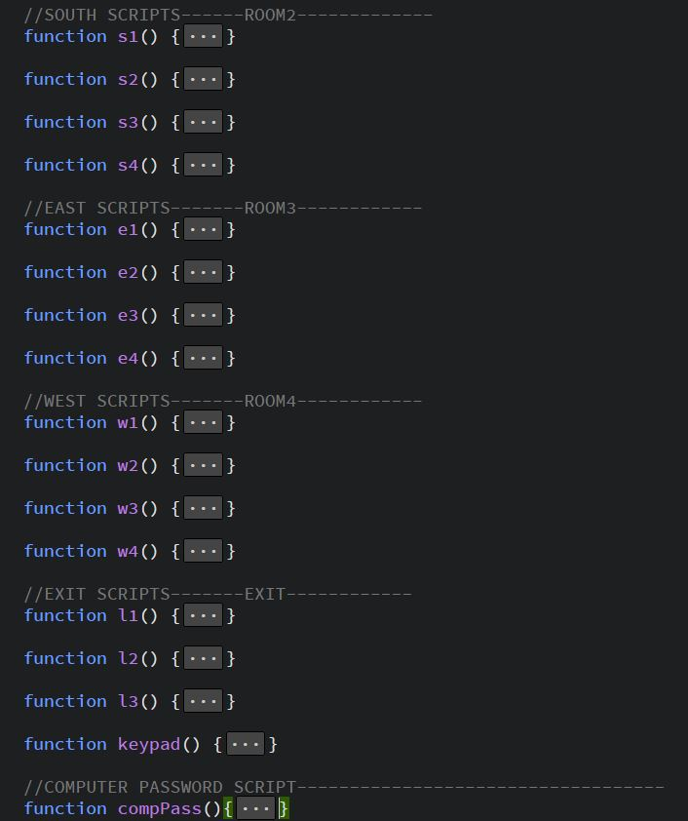
Project 3: Escape the madman - Document
Most Documentation was used to section off areas.
Sectioning off scripts and buttons made it easier to navigate.

Slide 21
Project 3: Escape the madman - Reflection
Positives
Writing out a story was fun.
Challenging to find how I wanted to execute the story.
Negatives
Much of the same
Limited on my knowledge.

Slide 22
Work Cited
Outrage. “HOW TO WALL JUMP IN UNITY - EASY TUTORIAL.” YouTube, YouTube, 10 Apr. 2020, www.youtube.com/watch?v=koDg2Mw1kEc.

